Slide 1
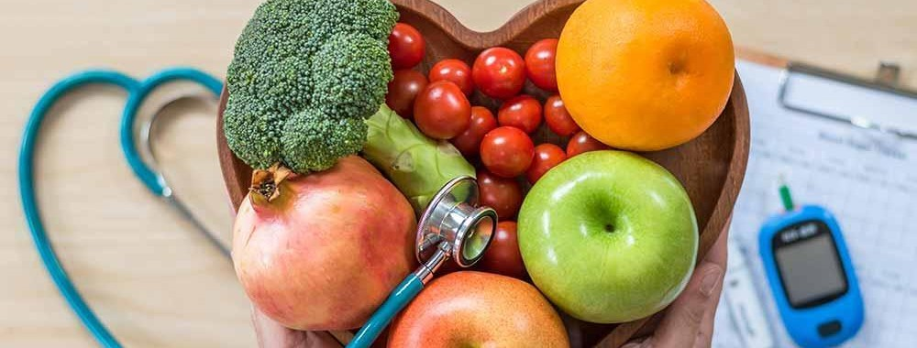
Madhuri Yadav • Sharmin Kantharia • Trinh Vu

Slide 2


●
●
AIM:

Slide 3








●
●
●
●
○
○
○
○
○

Slide 4












ows ×

Slide 5
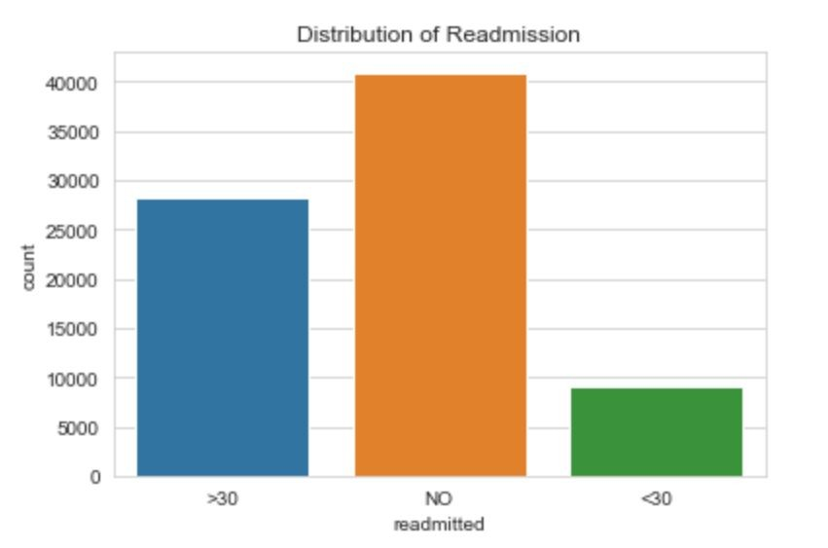
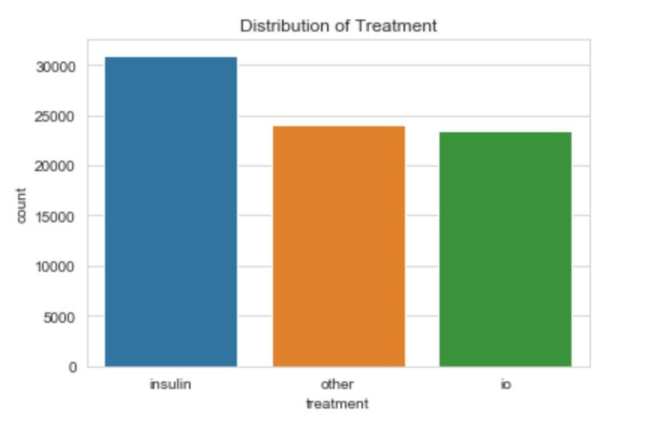


Slide 6
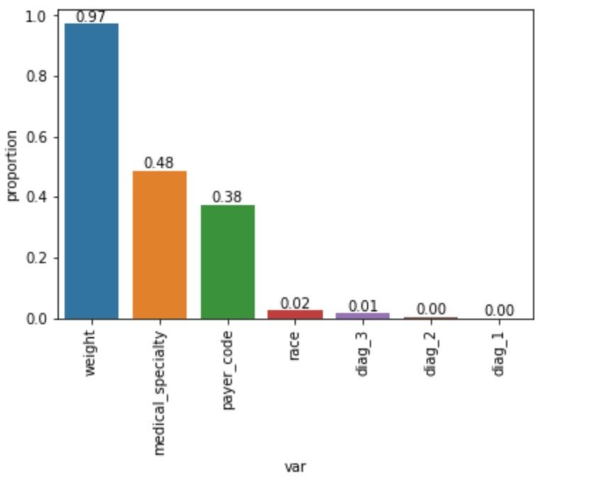









Slide 7
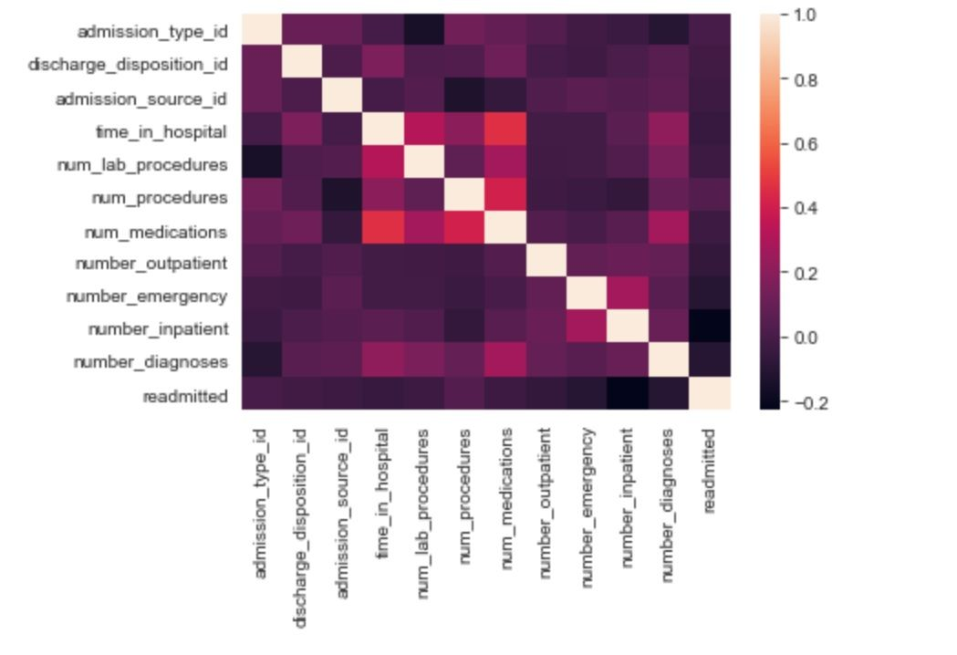

Slide 8

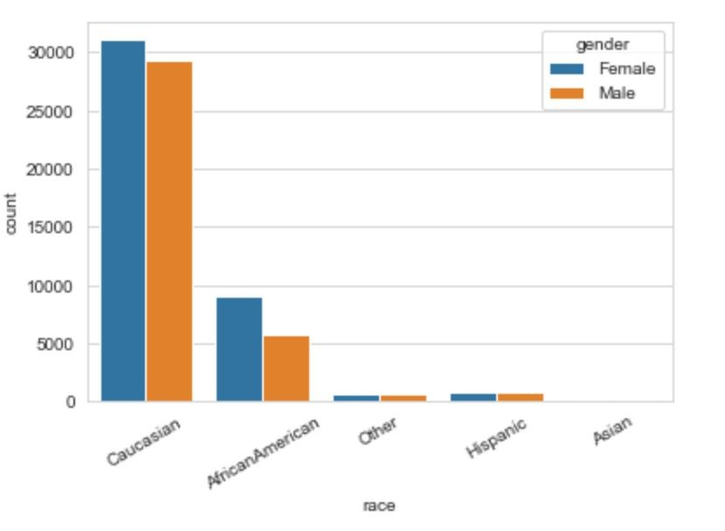

Slide 9






Modeling and Prediction –
Re-admission
●
●
●
●
●
●

Slide 10
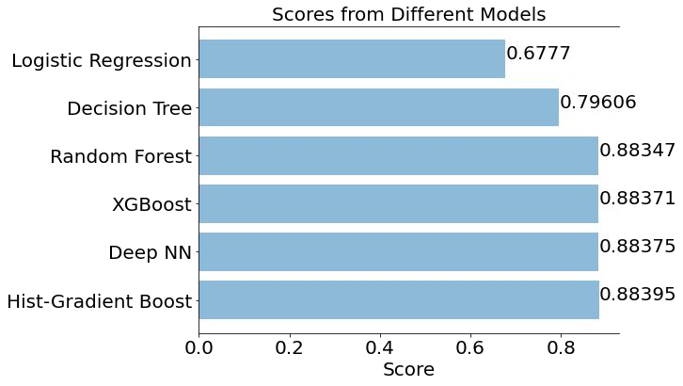

●
●
●
●
Scores for Diﬀerent Models for Readmission

Slide 11



●
●
●
●
●
Modeling and Prediction –
Treatments
●
●
●
●

Slide 12
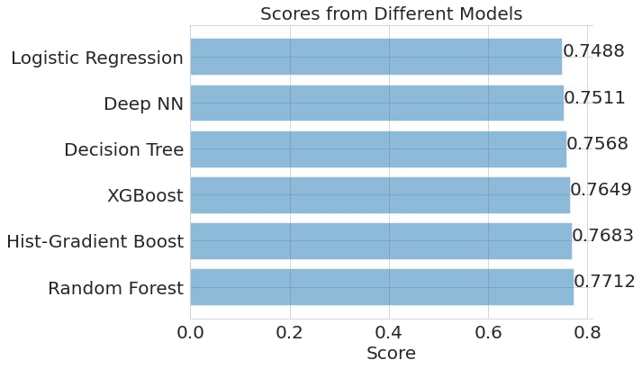
●
●
●
●
Scores for Diﬀerent Models for Treatment

Slide 13





●
●
●

